Slide 1
Hiring Process Analytics
By- Shweta Kushwaha

Slide 2
Project Description
This Project analyzing the company's hiring process data because the hiring process is a crucial function of any company, and understanding trends such as the number of rejections, interviews, job types, and vacancies can provide valuable insights for the hiring department. In this project as a lead data analyst company has provided with data records of their previous hiring and have asked to answer certain questions making sense out of that data.

Slide 3
Approach
Download the dataset which is provided.
For this project I used Microsoft Excel to run my queries.
Analyze the solutions
Noted all queries

Slide 4
Tech-Stack Used
I used Microsoft Excel to run queries and this spreadsheet is developed by Microsoft for various operating systems like Windows, MacOS etc.

Slide 5
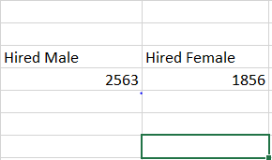
Determining the gender distribution of hires. Number of males and females have been hired by the company
I used following commands:
=COUNTIFS(D2:D7169,"Male",C2:C7169, "Hired")
=COUNTIFS(D2:D7169, "Female", C2:C7169, "Hired")

Slide 6
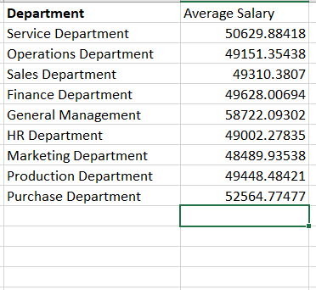
The average salary offered by this company
I used following commands:
=AVERAGEIFS(G2:G7169,E2:E7169,"Service Department")
=AVERAGEIFS(G2:G7169, E2:E7169, "Operations Department" )
=AVERAGEIFS(G2:G7169, E2:E7169, "Sales Department" )
=AVERAGEIFS(G2:G7169, E2:E7169, "Finance Department" )
=AVERAGEIFS(G2:G7169, E2:E7169, "General Management" )
=AVERAGEIFS(G2:G7169, E2:E7169, "Human Resource Department" )
=AVERAGEIFS(G2:G7169, E2:E7169, "Marketing Department" )
=AVERAGEIFS(G2:G7169, E2:E7169, "Production Department" )
=AVERAGEIFS(G2:G7169, E2:E7169, "Purchase Department" )

Slide 7
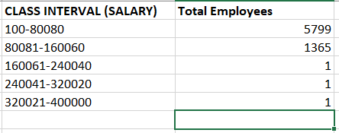
Created class intervals for the salaries in the company.
I used following commands:
=COUNTIFS(G2:G7169,">=100",G2:G7169,"<=80080")
=COUNTIFS(G2:G7169,">=80081",G2:G7169,"<=160060")
=COUNTIFS(G2:G7169,">=160061",G2:G7169,"<=240040")
=COUNTIFS(G2:G7169,">=240041",G2:G7169,"<=320020")
=COUNTIFS(G2:G7169,">=320021",G2:G7169,"<=400000")

Slide 8
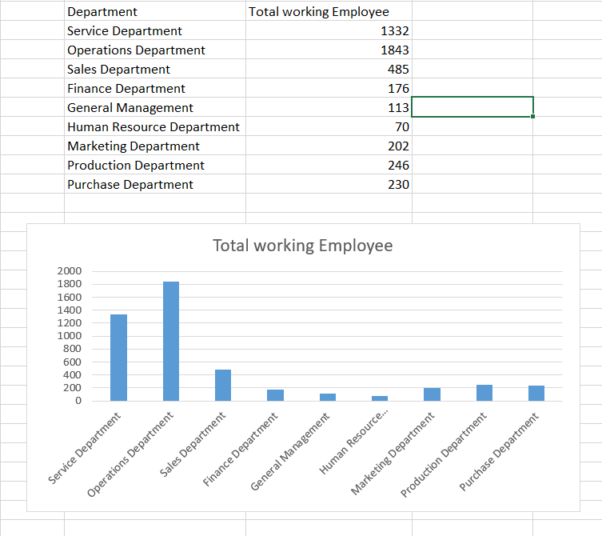
Used a bar graph visualization to show the proportion of people working in different departments.
I used following commands:
=COUNTIFS(E2:E7169, "Service Department", C2:C7169, "Hired")
=COUNTIFS(E2:E7169, "Operations Department", C2:C7169, "Hired")
=COUNTIFS(E2:E7169, "Sales Department", C2:C7169, "Hired")
=COUNTIFS(E2:E7169, "Finance Department", C2:C7169, "Hired")
=COUNTIFS(E2:E7169, "General Management", C2:C7169, "Hired")
=COUNTIFS(E2:E7169, "Human Resource Department", C2:C7169, "Hired")
=COUNTIFS(E2:E7169, "Marketing Department", C2:C7169, "Hired")
=COUNTIFS(E2:E7169, "Production Department", C2:C7169, "Hired")
=COUNTIFS(E2:E7169, "Purchase Department", C2:C7169, "Hired")

Slide 9
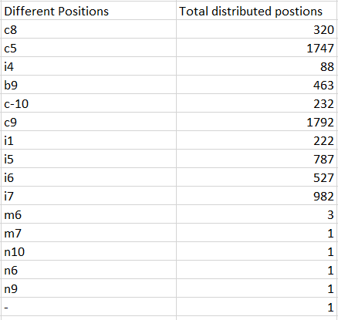
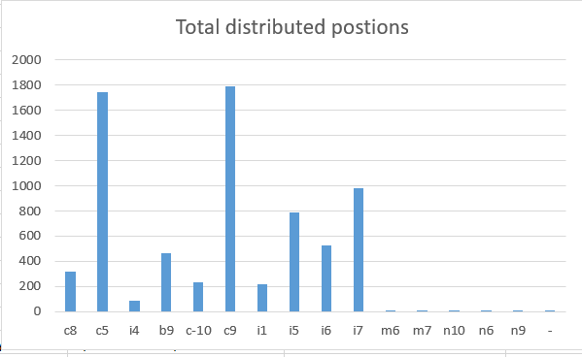
Used a graph to represent the different position tiers within the company. This will help you understand the distribution of positions across different tiers.
I used following commands:
=COUNTIF(F2:F7169, "c8")
=COUNTIF(F2:F7169, "c5")
=COUNTIF(F2:F7169, “i4")
=COUNTIF(F2:F7169, "b9")
=COUNTIF(F2:F7169, "c-10")
=COUNTIF(F2:F7169, "c9")
=COUNTIF(F2:F7169, "i1")
=COUNTIF(F2:F7169, "i5")
=COUNTIF(F2:F7169, "i6")
=COUNTIF(F2:F7169, "i7")
=COUNTIF(F2:F7169, "m6")
=COUNTIF(F2:F7169, "m7")
=COUNTIF(F2:F7169, "n10")
=COUNTIF(F2:F7169, "n6")
=COUNTIF(F2:F7169, "n9")
=COUNTIF(F2:F7169, "-")

Slide 10
Insights
Company holds 2536 males and 1856 females who are hired to work.
As per the data general management has high number of average salary and marketing department has lowest average among all the departments.
Operation department has more number of people who are working in it whereas, Human Resource Department has less number of people.

Slide 11
Result
This project help in learning new terms and methods used in Excel. It help in getting a deep insight of a crucial function of any company, and understanding trends such as the number of rejections, interviews, job types, and vacancies can provide valuable insights for the hiring department. In the hiring process it brings new individuals into the organization for various roles and eventually learnt the practical use of the concepts taught in the training.

